Slide 1
OLTP vs OLAP

Slide 2
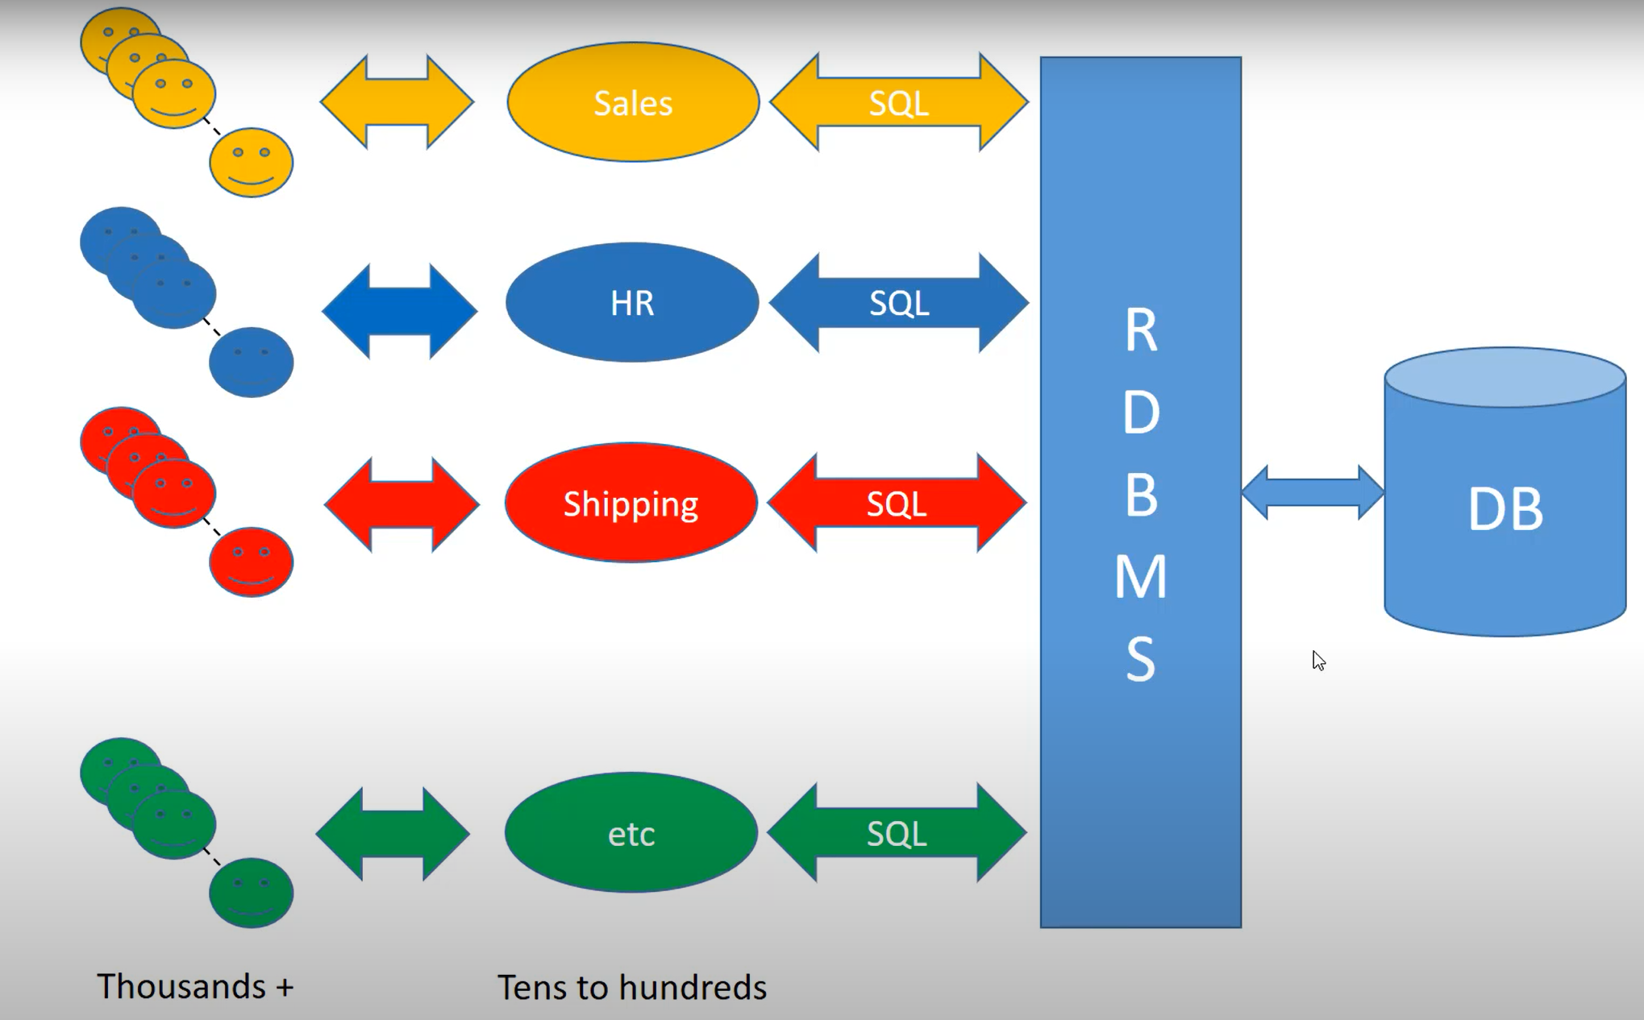
Online Transaction Processing (OLTP) systems
OLTP, or online transactional processing, systems enable the real-time execution of large numbers of database transactions by large numbers of people, typically over the internet.
OLTP systems are designed for use by frontline workers (e.g., cashiers, bank tellers, part desk clerks) or for customer self-service applications (e.g., online banking, e-commerce, travel reservations)
Process a large number of relatively simple transactions
Enable multi-user access to the same data, while ensuring data integrity
Emphasize very rapid processing, with response times measured in milliseconds
Provide indexed data sets
Are available 24/7/365

Slide 3
OLTP Architecture
OLTP systems are built on top of databases → The design of relational databases for OLTP systems is part art and part science:
Not all systems deserve the level of thought and diligence in creating the foundation that an OLTP system needs.
For a simple single-user application that does not integrate with any other system and has a short predicted life, there is no need to put huge effort into the data model or even use a relational database (although a good data model can reduce programming effort, and SQL is a well-known, convenient data access language.)
If there are plans for a system to grow, support multiple users, integrate with other systems, or have a long lifespan, time spent on the data model will pay for itself many times over during the life of the system(s).
Ref:
https://www.imaginarycloud.com/blog/oltp-vs-olap/
https://www.ibm.com/topics/oltp
Notes:
https://www.imaginarycloud.com/blog/oltp-vs-ola
The requirements are subtle and involve trade-offs among the requirements.
There are many ways to model the data; each model has its strengths and weaknesses; Data models are not right and wrong, they are better or worse
Complexity: The data model must represent the organization - In most cases the designer is not an expert in the organization’s industry, business model, procedures, and goals.
p/

Slide 4
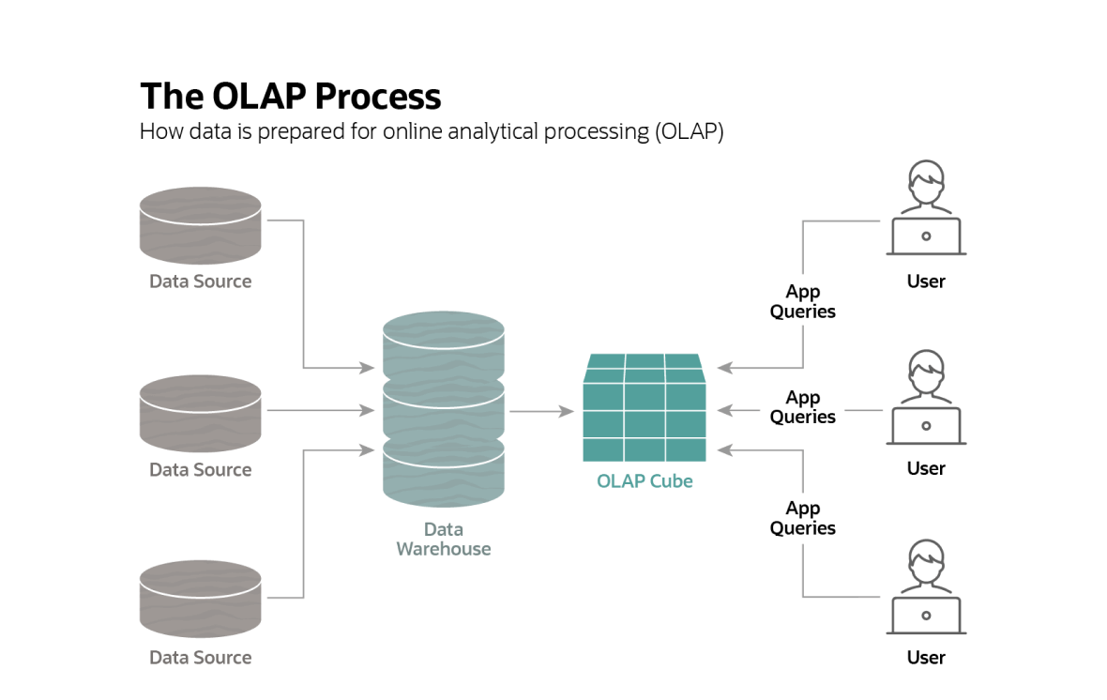
Online Analytical Processing (OLAP) Systems
OLAP (Online Analytical Processing) systems:
optimized for conducting complex data analysis
support business intelligence (BI), data mining, and other decision support applications
designed for use by data scientists, business analysts, and knowledge workers
Notes:
https://www.netsuite.com/portal/resource/articles/erp/online-analytical-processing-olap.shtml

Slide 5
OLTP vs. OLAP
There are several distinct technical differences OLTP and OLAP systems:
OLTP systems use a relational database that can accommodate a large number of concurrent users and frequent queries and updates, while supporting very fast response times. OLAP systems use a multidimensional database—a special kind of database created from multiple relational databases that enables complex queries of involving multiple data facts from current and historical data. (An OLAP database may be organized as a data warehouse.)
OLTP queries are simple and typically involve just one or a few database records. OLAP queries are complex queries involving large numbers of records.
OLTP transaction and query response times are lightning-fast; OLAP response times are orders of magnitude slower.
OLTP systems modify data frequently (this is the nature of transactional processing); OLAP systems do not modify data at all.
OLTP workloads involve a balance of read and write; OLAP workloads are read-intensive.
OLTP databases require relatively little storage space; OLAP databases work with enormous data sets and typically have significant storage space requirements.
OLTP systems require frequent or concurrent backups; OLAP systems can be backed up far less frequently.

Slide 6
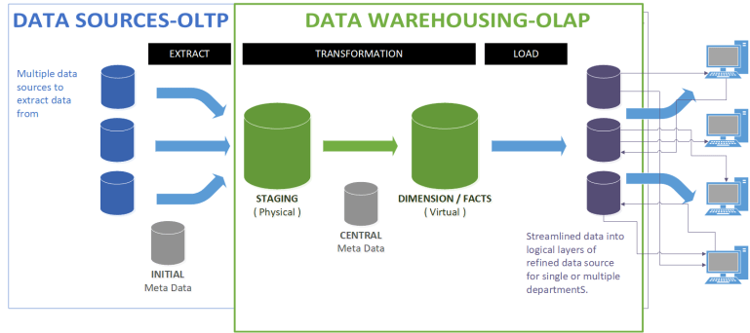
OLTP vs. OLAP
OLTP systems often serve as a source of information for OLAP systems.
Often, the goal of the analytics performed using OLAP is to improve business strategy and optimize business processes, which can provide a basis for making improvements to the OLTP system.

